Slide 1

MACHINE LEARNING
By Jagannath Banerjee

Slide 2
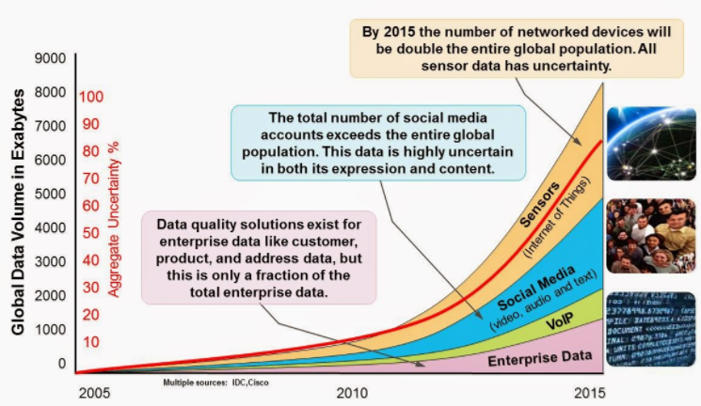
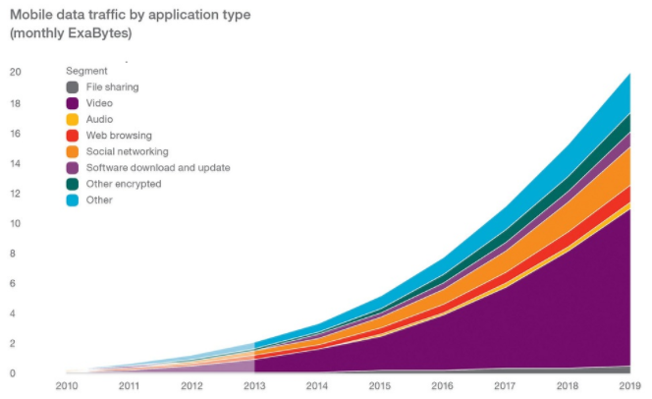
Data Science
Data science, also known as data-driven science, is an interdisciplinary field of scientific methods, processes, and systems to extract knowledge or insights from data in various forms, either structured or unstructured, similar to data mining.
It’s a mix of Math , Statistics and Computer Programming
Big data is data sets that are so voluminous and complex that traditional data processing application software are inadequate to deal with them. Big data challenges include capturing data, data storage, data analysis, search, sharing, transfer, visualization, querying, updating and information privacy.
3 V’s - Volume, Variety and Velocity.

Slide 3
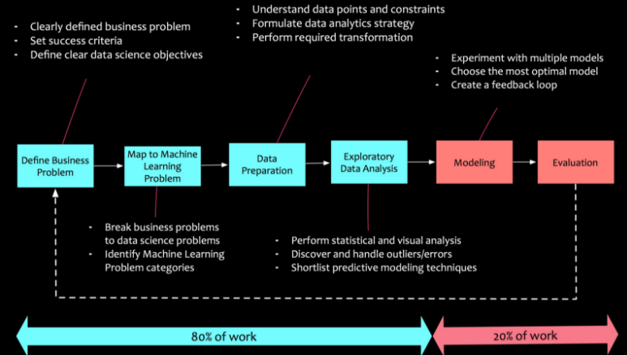
Data Science Process

Slide 4
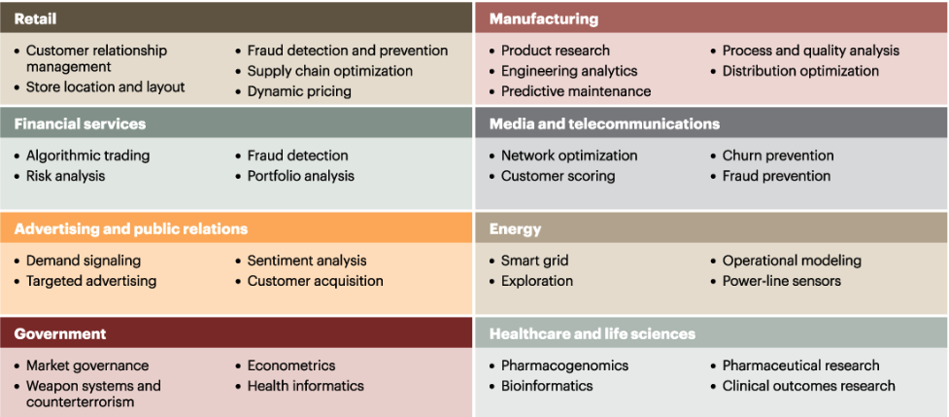
What is Machine Learning ?
Machine learning is a field of computer science that gives computers the ability to learn without being explicitly programmed. Arthur Samuel coined the term in 1959
Focuses on studying and constructing algorithm learn can learn and make prediction on data
ML Use Case :

Slide 5
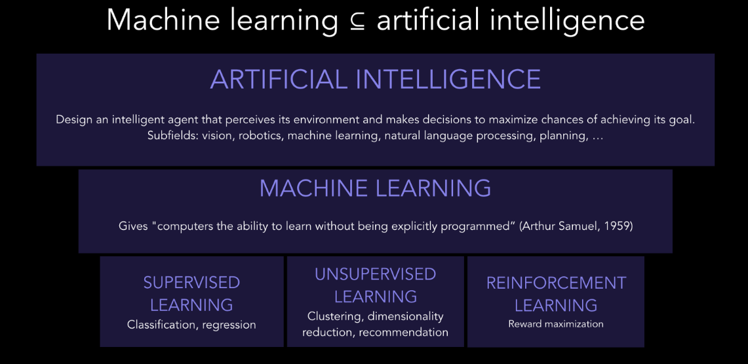
AI vs ML

Slide 6
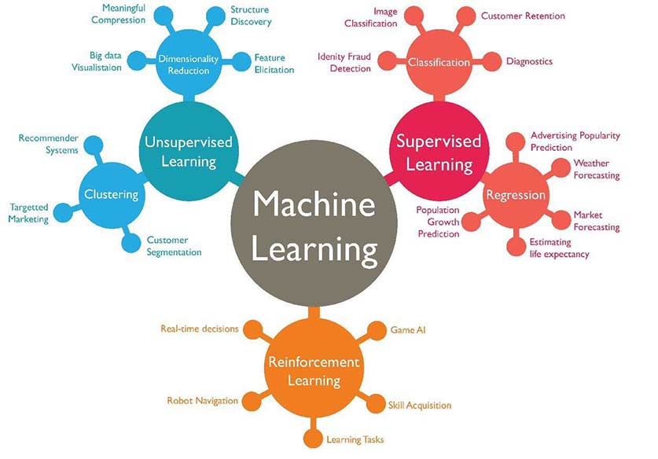
High Level Segmentation

Slide 7
Supervised Learning - Regression
Simple Linear Regression
Multiple Linear Regression
Polynomial Regression

Slide 8
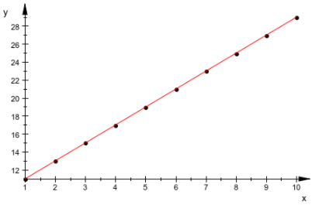
Simple Linear Regression
Simple Linear Regression models the linear relationship between the magnitude between one variable (X) and that of other (Y) . Eg- Directly proportional or Inversely proportional
Co-relation measures strength of association b/w two variables
Regression quantifies the nature of relationship
Linear Regression Equation :
Y= B0 + B1X
Y: Also called dependent variable , target variable, outcome variable, response variable
X: independent variable, feature, attribute , predictor variable
B0 : Intercept (Y when X=0)
B1 : Slope ( increase in Y per unit increase in X)

Slide 9
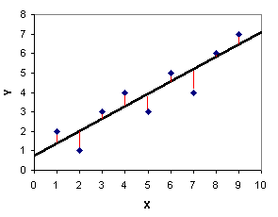
Simple Linear Regression
Regression Line – Best Fitted line
Y – Actual data point ; Y^ - Point on Regression Line ; Difference (Y-Y^) is residual (in red)
Residual Sum of Square (RSS)
RSS = summation of [(Yi – Yi^) ^2]
Least Square Regression :
Minimizing the sum of squared residual
Regression Line (fitted value)
Actual Observation

Slide 10
Multiple Linear Regression
Simple Linear Regression – Y=B0 + B1X
Multiple Linear Regression – Y=B0 + B1*X1 + B2*X2 +………….+ BN*XN
Y: Also called dependent variable , target variable, outcome variable, response variable
X1,X2,..,XN: independent variable, feature, attribute , predictor variable
B0 : Intercept (Y when X1,X2,..,XN=0)
B1,B2,..,BN : Slope ( increase in Y per unit increase in X)

Slide 11
Multiple Linear Regression - Assumptions
Linearity - Linear regression needs the relationship between the independent and dependent variables to be linear. It is also important to check for outliers since linear regression is sensitive to outlier effects. The linearity assumption can best be tested with scatter plot
Homoscedastic - Homoscedasticity describes a situation in which the error term (that is, the “noise” or random disturbance in the relationship between the independent variables and the dependent variable) is the same across all values of the independent variables
Multivariate Normality - Secondly, the linear regression analysis requires all variables to be multivariate normal (Assumption can be checked using histogram or a Q-Q-Plot)
Independence of Errors
Lack of Multicollinearity - linear regression assumes that there is little or no multicollinearity in the data. Multicollinearity occurs when the independent variables are too highly correlated with each other. It happens when a variable is included multiple times, P dummy var instead of P-1, two variables are nearly perfectly co-related with one another

Slide 12
Multiple Linear Regression – Dummy variable
R&D Spend | Administration | Marketing Spend | State | Profit
$ 165,349.20 | $ 136,897.80 | $ 471,784.10 | New York | $ 192,261.83
$ 162,597.70 | $ 151,377.59 | $ 443,898.53 | California | $ 191,792.06
$ 153,441.51 | $ 101,145.55 | $ 407,934.54 | Florida | $ 191,050.39
$ 144,372.41 | $ 118,671.85 | $ 383,199.62 | New York | $ 182,901.99
$ 142,107.34 | $ 91,391.77 | $ 366,168.42 | Florida | $ 166,187.94
$ 131,876.90 | $ 99,814.71 | $ 362,861.36 | New York | $ 156,991.12
$ 134,615.46 | $ 147,198.87 | $ 127,716.82 | California | $ 156,122.51
$ 130,298.13 | $ 145,530.06 | $ 323,876.68 | Florida | $ 155,752.60
$ 120,542.52 | $ 148,718.95 | $ 311,613.29 | New York | $ 152,211.77
Categorical Variable -> (Row will convert into column)
Y=B0 + B1*X1 + B2*X2 +B3*X3+ B4*X4

Slide 13
Multiple Linear Regression – Dummy variable
Dummy Variable
R&D Spend | Administration | Marketing Spend | State | Profit |  | NY | CA | FL
$ 165,349.20 | $ 136,897.80 | $ 471,784.10 | New York | $ 192,261.83 |  | 1 | 0 | 0
$ 162,597.70 | $ 151,377.59 | $ 443,898.53 | California | $ 191,792.06 |  | 0 | 1 | 0
$ 153,441.51 | $ 101,145.55 | $ 407,934.54 | Florida | $ 191,050.39 |  | 0 | 0 | 1
$ 144,372.41 | $ 118,671.85 | $ 383,199.62 | New York | $ 182,901.99 |  | 1 | 0 | 0
$ 142,107.34 | $ 91,391.77 | $ 366,168.42 | Florida | $ 166,187.94 |  | 0 | 0 | 1
$ 131,876.90 | $ 99,814.71 | $ 362,861.36 | New York | $ 156,991.12 |  | 1 | 0 | 0
$ 134,615.46 | $ 147,198.87 | $ 127,716.82 | California | $ 156,122.51 |  | 0 | 1 | 0
$ 130,298.13 | $ 145,530.06 | $ 323,876.68 | Florida | $ 155,752.60 |  | 0 | 0 | 1
$ 120,542.52 | $ 148,718.95 | $ 311,613.29 | New York | $ 152,211.77 |  | 1 | 0 | 0
Y=B0(1) + B1*X1 + B2*X2 +B3*X3+ B4 B4*D1 + B5*D2
Always omit 1 dummy Variable
D3 = 1- D1 – D2
B0 will adjust for the omitted dummy variable

Slide 14
Why can’t we use all variables?
Garbage in = Garbage out
2. Difficult to explain

Slide 15
What is p Value ?
P value measures the extent to which a coefficient is statistically significant. The p-value is 0.0308 means we would expect to achieve same results by random chances over 30% of time.
While performing hypothesis test in statistics, a p-value helps you determine the significance of our results. This claim that’s on trial, in essence, is called the null hypothesis.
Hypothesis tests are used to test the validity of a claim that is made about a population.
All hypothesis tests ultimately use a p-value to weigh the strength of the evidence (what the data are telling you about the population).
The p-value is a number between 0 and 1 and interpreted in the following way:
A small p-value (typically ≤ 0.05) indicates strong evidence against the null hypothesis, so you reject the null hypothesis.
A large p-value (> 0.05) indicates weak evidence against the null hypothesis, so you fail to reject the null hypothesis.
p-values very close to the cutoff (0.05) are considered to be marginal (could go either way). Always report the p-value so your readers can draw their own conclusions.

Slide 16
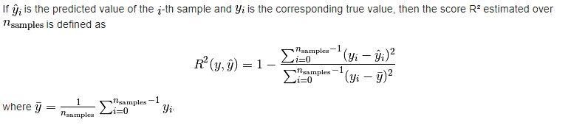
Linear Regression – Performance Parameter
R2 (Co-efficient of Determination):
It provides a measure of how well future samples are likely to be predicted by the model.
R2 = 1.0 - Best possible score
R2 = 0.0 - A constant model that always predicts the expected value of y, disregarding the input features
R2 = Neg – The model can be arbitrarily worse
from sklearn.metrics import r2_score
print("R2 Score-",r2_score(y_test, y_pred) )

Slide 17
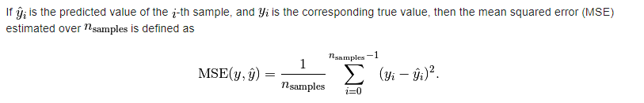
Linear Regression – Performance Parameter
Mean Squared Error (MSE) :
It is an estimator measuring the average of the squares of the errors or deviations—that is, the difference between the estimator and what is estimated.
The MSE is a measure of the quality of an estimator.
MSE is always non-negative, and values closer to zero are better.
from sklearn.metrics import mean_squared_error
mean_squared_error(y_true, y_pred)
http://scikit-learn.org/stable/modules/model_evaluation.html#regression-metrics

Slide 18
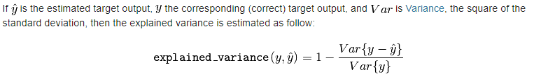
Linear Regression – Performance Parameter
Variance Score :
Calculated Variance Regression Score
Variance = 1.0 - Best possible score
Variance = Lower values are worse
from sklearn.metrics import explained_variance_score
explained_variance_score(y_true, y_pred)
explained_variance_score(y_true, y_pred, multioutput='raw_values')
Ref : http://scikit-learn.org/stable/modules/model_evaluation.html#explained-variance-score

Slide 19
Model Selection – K Fold Cross Validation
when you do K-fold cross validation, you are testing how well your model is able to get trained by some data and then predict data it hasn't seen. We use cross validation for this because if you train using all the data you have, you have none left for testing. You could do this once, say by using 80% of the data to train and 20% to test, but what if the 20% you happened to pick to test happens to contain a bunch of points that are particularly easy (or particularly hard) to predict? We will not have come up with the best estimate possible of the models ability to learn and predict.
We want to use all of the data. So to continue the above example of an 80/20 split, we would do 5-fold cross validation by training the model 5 times on 80% of the data and testing on 20%. We ensure that each data point ends up in the 20% test set exactly once. We've therefore used every data point we have to contribute to an understanding of how well our model performs the task of learning from some data and predicting some new data.
But the purpose of cross-validation is not to come up with our final model. We don't use these 5 instances of our trained model to do any real prediction. For that we want to use all the data we have to come up with the best model possible. The purpose of cross-validation is model checking, not model building.
Now, say we have two models, say a linear regression model and a neural network. How can we say which model is better? We can do K-fold cross-validation and see which one proves better at predicting the test set points. But once we have used cross-validation to select the better performing model, we train that model (whether it be the linear regression or the neural network) on all the data. We don't use the actual model instances we trained during cross-validation for our final predictive model.

Slide 20
Model Selection – K Fold Cross Validation
#k-fold cross validation
from sklearn.model_selection import cross_val_score
cvs = cross_val_score(regressor, X=X_train, y=y_train, cv=20)
print ("Mean accuracy:",cvs.mean())
print ("Standard Dev:",cvs.std())

Slide 21
Multiple Regression – Additional Knowledge
Adding more variables does not mean we have a better model. Simpler model should be used.
Including additional variables always reduces RMSE and increases R2 . So they should not be used for model choice. Use forward or Backward Selection
Forward Selection - Start with no predictors and add them one by one. Each step add the predictor that has largest contribution to R2.
Backward Selection – Start with full model and take away the predictors that are not statistically significant
Regression Models should not be used to extrapolate beyond the range of data.
Factor variables/Categorical variables are of 2 types :
Normal categorical (like – Single home, Townhome, Apartment etc) – Use binaries
Order categorical variable (Poor, Fair, Good and Excellent) – Numeric value ordered from low to high.
Co-related Predictors – When the predictor variables are highly co-related , it is difficult to interpret the individual co-efficient
Multicollinearity – When the predictor variable have perfect or near perfect co-relation the regression can be unstable or impossible to compute
Confounding variable – Important predictor when omitted can lead to spurious results.

Slide 22
Regression Diagnostics
Outliers must be handled/removed. In regression an outlier is a record whose actual “y” value is distant from predicted value. Outlier can be determined using standardized residuals (residual/standard error of residual) . Outliers are data points that are too far above or below the box boundaries (generally 1.5 times the inter-quartile range)
Influence Values – Influence of single record on regression
Hat Value
Cook’s distance
Partial Residual Plot- Way to visualize how well the estimated fit explains the relationship between a predictor and outcome.

Slide 23
Non Linear - Polynomial Regression
Relationship between response variable (y) and predictor variable (x) is not linear and modelled as nth degree polynomial
- Response to dose of drug
- Demand of a product
- Human Performance with respect to time
Non Linear regression model are the ones that cannot be fit into ordinary least squares
They are harder and computation intensive
Definition –” In statistics, polynomial regression is a form of regression analysis in which the relationship between the independent variable x and the dependent variable y is modelled as an nth degree polynomial in x.”
Adding a higher order polynomial such as cubic, quatric leads to undesirable wiggles

Slide 24
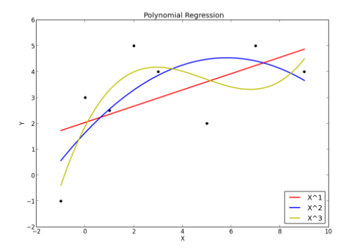
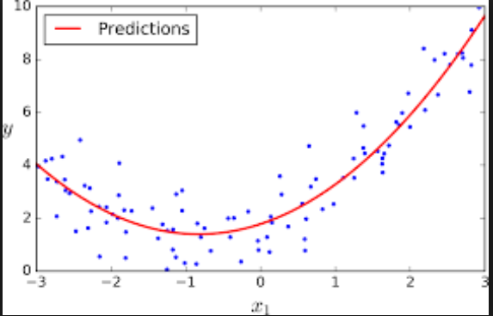
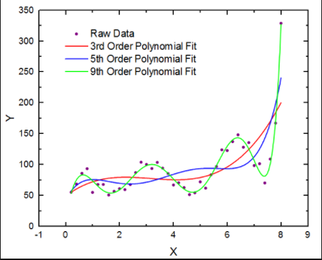
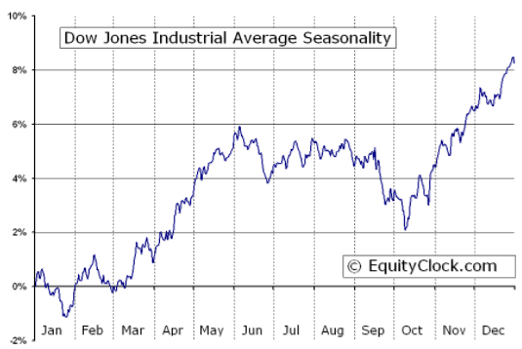

Slide 25
Non Linear - Polynomial Regression - Disadvantage
Strong sensitivity to Outliers – Presence of one or two outliers can seriously affect the result.
Few Model validation tool.

Slide 26
Support Vector Regression
Support vector regression (SVR) is a fast and accurate way of interpolating data sets
It is useful when you have an expensive function you want to approximate over a known domain
Support vector regression is a generalization of the support vector machine to the regression problem - It requires a training set, which covers the domain of interest and is accompanied by solutions on that domain
The work of the SVM is to approximate the function we used to generate the training set
A support vector machine constructs a hyper-plane or set of hyper-planes in a high or infinite dimensional space, which can be used for classification, regression or other tasks. Intuitively, a good separation is achieved by the hyper-plane that has the largest distance to the nearest training data points of any class (so-called functionaof the classifier. l margin), since in general the larger the margin the lower the generalization error
In SVR ,vectors are used to perform linear regression. The vectors closest to the test point, or decision boundary are the ones we refer to as support vectors. For regression, it turns out that all of the vectors are support vectors. We can evaluate our function anywhere, so any vectors could be closest to our test evaluation location.

Slide 27
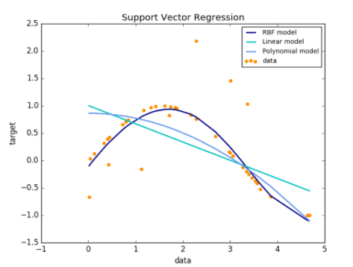
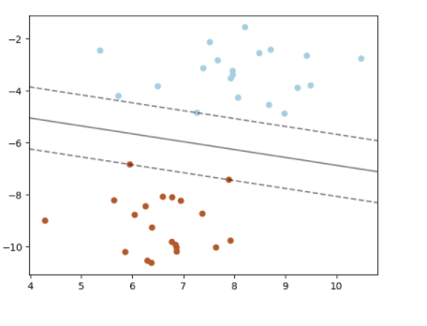
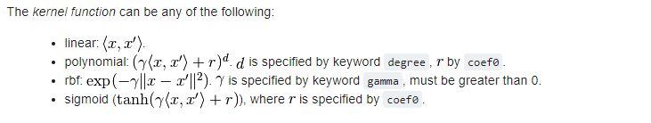
Support Vector Regression
rbf : radial basis function

Slide 28
Decision Tree
CART - Classification & Regression Tree
Decision tree builds regression or classification models in the form of a tree structure.
It brakes down a dataset into smaller and smaller subsets while at the same time an associated decision tree is incrementally developed.
The final result is a tree with decision nodes and leaf nodes.
A decision node (e.g., Outlook) has two or more branches (e.g., Sunny, Overcast and Rainy), each representing values for the attribute tested.
Leaf node (e.g., Hours Played) represents a decision on the numerical target.
The topmost decision node in a tree which corresponds to the best predictor called root node.
Decision trees can handle both categorical and numerical data.
A decision tree is built top-down from a root node and involves partitioning the data into subsets that contain instances with similar values (homogenous)
Ref : http://www.saedsayad.com/decision_tree_reg.htm
Decision Tree algorithm can find the optimum splits

Slide 29
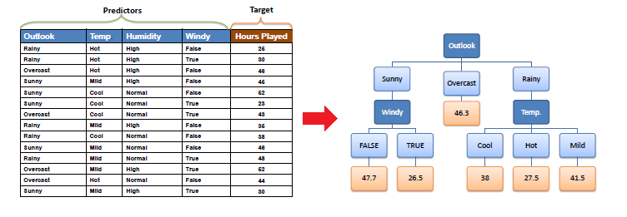
Decision Tree
Decision Node
Leaf Node

Slide 30
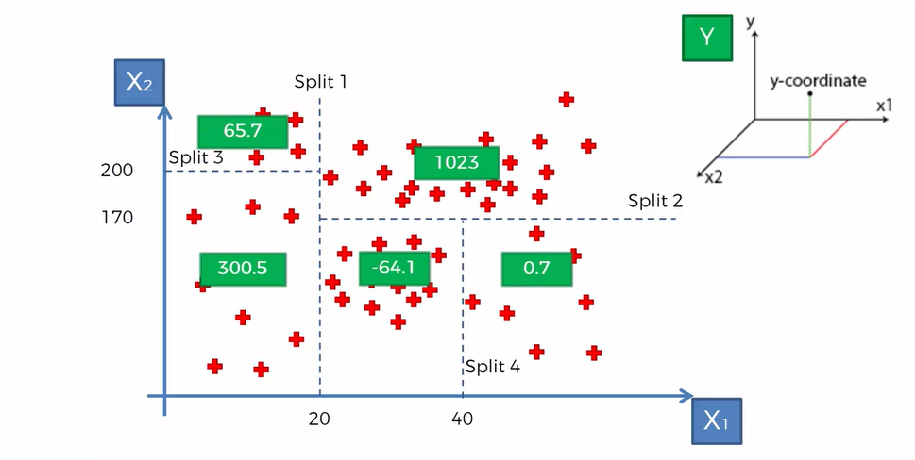
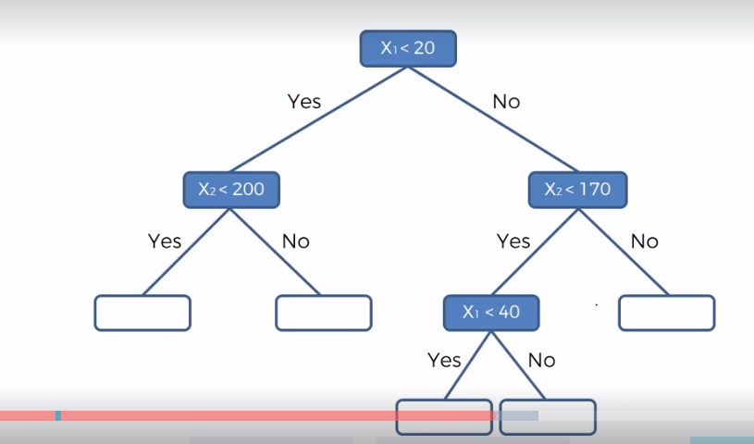
Decision Tree
Y is the average of the split section

Slide 31
Decision Tree – Advantage
1: Decision trees implicitly perform variable screening or feature selection
2: Decision trees require relatively little effort from users for data preparation
3: Nonlinear relationships between parameters do not affect tree performance
4: The best feature of using trees for analytics - easy to interpret and explain to executives!

Slide 32
Decision Tree – Advantage & Disadvantage
1. Overfitting - Prone to Overfitting
2. Tree structure prone to sampling – While Decision Trees are generally robust to outliers, due to their tendency to overfit, they are prone to sampling errors. If sampled training data is somewhat different than evaluation or scoring data, then Decision Trees tend not to produce great results.
3. Tree splitting is locally greedy – At each level, tree looks for binary split such that impurity of tree is reduced by maximum amount. This is a greedy algorithm and achieves local optima. It may be possible, for example, to achieve less than maximum drop in impurity at current level, so as to achieve lowest possible impurity of final tree, but tree splitting algorithm cannot see far beyond the current level. This means that Decision Tree built is typically locally optimal and not globally optimal or best.
4. Optimal decision tree is NP-complete problem – Because of number of feature variables, potential number of split points, and large depth of tree, total number of trees from same input dataset is unimaginably humongous. Thus, not only tree splitting is not global, computation of globally optimal tree is also practically impossible.

Slide 33
Random Forest
A random forest is a meta estimator that fits a number of decision tree classifiers on various sub-samples of the dataset and use averaging to improve the predictive accuracy and control over-fitting. The sub-sample size is always the same as the original input sample size but the samples are drawn with replacement if bootstrap=True (default).
Pick random K data points from the training set
Build Decision tree associated to these K points
Choose the N trees you want to build and repeat Step 1 & 2
For a new data point , make each one of your N trees predict the value of Y for the data point in question and assign new data point the average across all of the predicted Y values

Slide 34
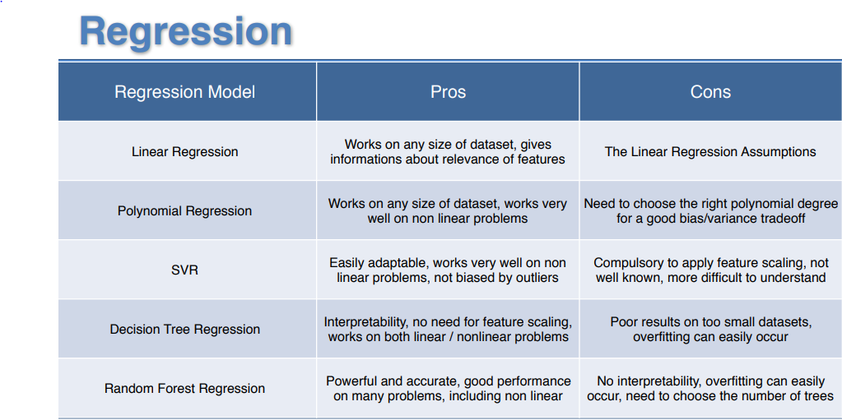
Regression – Pros & Cons

Slide 35
Regularization
Regularization in Machine Learning is an important concept and it solves the overfitting problem. It is very important to understand regularization to train a good model
Ridge Regression
Lasso
Elastic Net

Slide 36
Classification

Slide 37
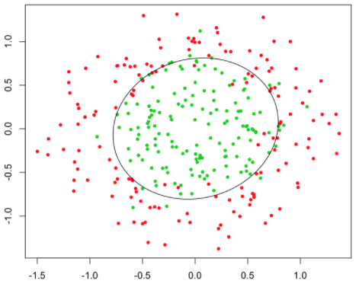
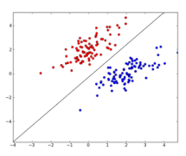
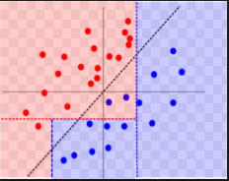
Classification
The main goal of classification is to predict the target class (Yes/ No). We are trying to predict a discrete number of values.
If the trained model is for predicting any of two target classes. It is known as binary classification
whether the student will pass or fail
whether customer will buy the new product or not
predict whether a Breast Cancer is Benign or Malignant.
Given an image correctly classify as containing Cats or Dogs.
given email predict whether it’s spam email or not
If we have to predict more the two target classes it is known as multi-classification
Classification vs Regression
If forecasting target class ( Classification )
If forecasting a value ( Regression )

Slide 38
Classification - Techniques
Logistic Regression
K-Nearest Neighbors (K-NN)
Support Vector Machine (SVM)
Kernel SVM
Naive Bayes
Decision Tree Classification
Random Forest Classification

Slide 39
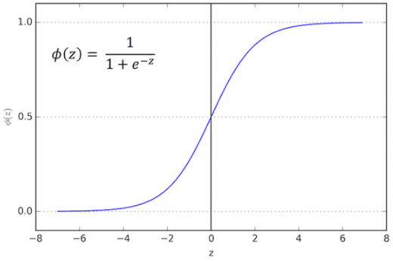
Classification – Logistics Regression
Sometimes we will instead wish to predict a discrete variable such as predicting whether a grid of pixel intensities represents a “0” digit or a “1” digit. This is a classification problem. Logistic regression is a simple classification algorithm for learning to make such decisions.
Sigmoid/logistic Function

Slide 40
Confusion Matrix
Predicted value
 | 0 | 1
0 | True Negative 50 | False Positive (Type – 1 Error) 10
1 | False Negative (Type 2 Error) 20 | True Positive 20
Actual Value
Accuracy Rate = Correct/Total
Error = Wrong / Total

Slide 41
Classification – K Nearest neighbor (KNN)
The principle behind nearest neighbor methods is to find a predefined number of training samples closest in distance to the new point, and predict the label from these
The number of samples can be a user-defined constant (k-nearest neighbor learning), or vary based on the local density of points (radius-based neighbor learning). The distance can, in general, be any metric measure: standard Euclidean distance is the most common choice
Despite its simplicity, nearest neighbors has been successful in a large number of classification and regression problems, including handwritten digits or satellite image scenes. Being a non-parametric method, it is often successful in classification situations where the decision boundary is very irregular

Slide 42
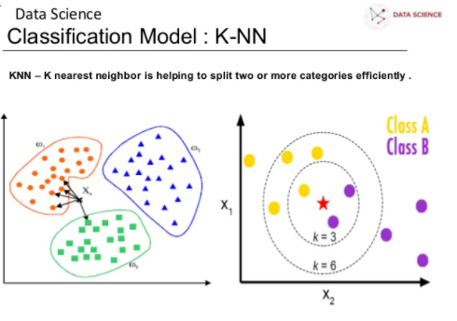
Classification – K Nearest neighbor (KNN)

Slide 43
Y
Y2
Y1
X1
X2
X
E(dist) = Sqrt((x2-x1)^2 + (y2-y1)^2)
Euclidian Distance

Slide 44
Classification – Support Vector Machine (SVM)
X2
X1
What is the optimum line -?

Slide 45
Classification – Support Vector Machine (SVM)
Positive Hyperplane
X2
Negative Hyperplane
Maximum Margin Hyperplane
X1
Support Vectors
What are they popular - ?
SVM works on linearly separable data

Slide 46
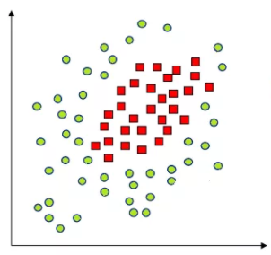
Classification – Kernel Support Vector Machine (k-SVM)
X2
X1
Linearly Separable- SVM
Non-Linearly separable
How do we separate this - ?

Slide 47
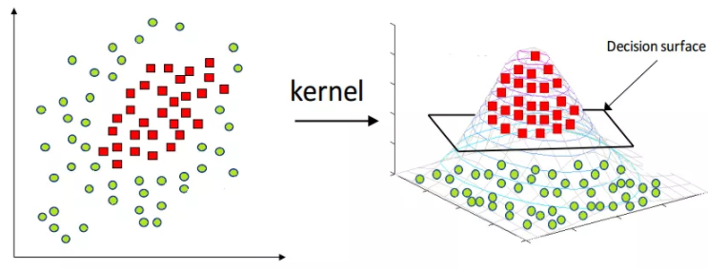
Classification – Kernel Support Vector Machine (k-SVM)
Add extra dimension
Mapping in higher dimension is computation intensive

Slide 48
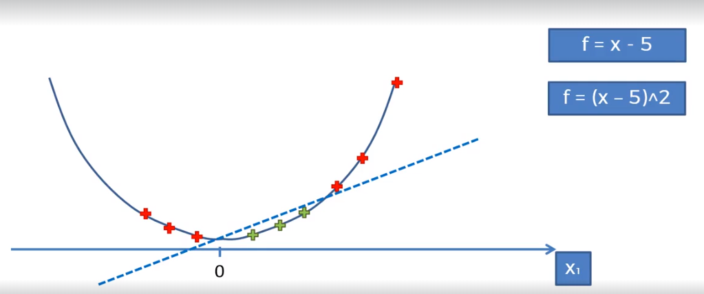
Classification – Kernel Support Vector Machine (k-SVM)

Slide 49
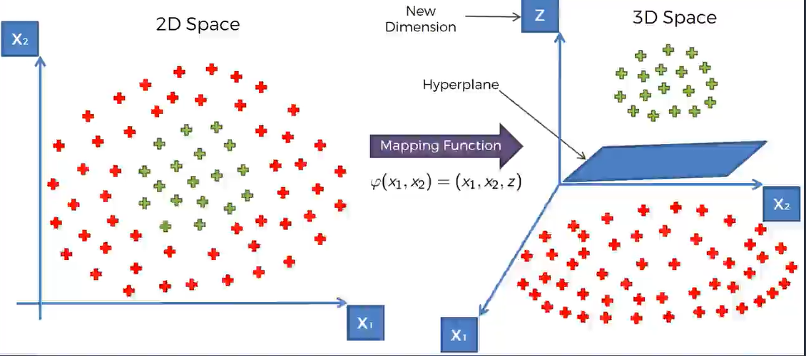
Classification – Kernel Support Vector Machine (k-SVM)

Slide 50
Classification – Kernel Support Vector Machine (k-SVM)
Kernels:
http://mlkernels.readthedocs.io/en/latest/kernels.html#rational-quadratic-kernel

